Slide 1
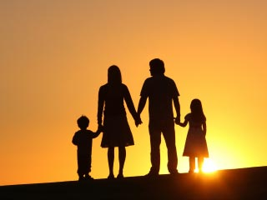
Want big impact? Use big image.
Rededicating our life, family & work to God
Sunday Svc
29 Dec 2019
Cecil Ang

Slide 2
Joshua 5 (ESV)
¹ As soon as all the kings of the Amorites who were beyond the Jordan to the west, and all the kings of the Canaanites who were by the sea, heard that the Lord had dried up the waters of the Jordan for the people of Israel until they had crossed over, their hearts melted and there was no longer any spirit in them because of the people of Israel.

Slide 3
Joshua 5 (ESV)
² At that time the Lord said to Joshua, “Make flint knives and circumcise the sons of Israel a second time.” ³ So Joshua made flint knives and circumcised the sons of Israel at Gibeath-haaraloth. ⁴ And this is the reason why Joshua circumcised them: all the males of the people who came out of Egypt, all the men of war, had died in the wilderness on the way after they had come out of Egypt.

Slide 4
Joshua 5 (ESV)
⁵ Though all the people who came out had been circumcised, yet all the people who were born on the way in the wilderness after they had come out of Egypt had not been circumcised. ⁶ For the people of Israel walked forty years in the wilderness, until all the nation, the men of war who came out of Egypt, perished, because they did not obey the voice of the Lord; the Lord swore to them that he would not let them see the land that the Lord had sworn to their fathers to give to us, a land flowing with milk and honey.

Slide 5
Joshua 5 (ESV)
⁷ So it was their children, whom he raised up in their place, that Joshua circumcised. For they were uncircumcised, because they had not been circumcised on the way. ⁸ When the circumcising of the whole nation was finished, they remained in their places in the camp until they were healed. ⁹ And the Lord said to Joshua, “Today I have rolled away the reproach of Egypt from you.” And so the name of that place is called Gilgal to this day.

Slide 6
Joshua 5 (ESV)
¹⁰ While the people of Israel were encamped at Gilgal, they kept the Passover on the fourteenth day of the month in the evening on the plains of Jericho. ¹¹ And the day after the Passover, on that very day, they ate of the produce of the land, unleavened cakes and parched grain^{. 12} And the manna ceased the day after they ate of the produce of the land. And there was no longer manna for the people of Israel, but they ate of the fruit of the land of Canaan that year.

Slide 7
Joshua 5 (ESV)
¹³ When Joshua was by Jericho, he lifted up his eyes and looked, and behold, a man was standing before him with his drawn sword in his hand. And Joshua went to him and said to him, “Are you for us, or for our adversaries?” ¹⁴ And he said, “No; but I am the commander of the army of the Lord. Now I have come.” And Joshua fell on his face to the earth and worshiped and said to him, “What does my lord say to his servant?”

Slide 8
Joshua 5 (ESV)
¹⁵ And the commander of the Lord's army said to Joshua, “Take off your sandals from your feet, for the place where you are standing is holy.” And Joshua did so.

Slide 9

1
Adjust our Priorities
Spiritual priorities before anything else

Slide 10
Adjust our Priorities
At that time the Lord said to Joshua, “Make flint knives and circumcise the sons of Israel a second time.” (v 2)
Renewal of the covenant of circumcision (Gen 17; Ex 4:24-26; Lev 12)
Celebration of the Passover (Ex 12)

Slide 11
Adjust our Priorities
Are we bound by the tyranny of Egypt?
Doubt – pining for the food in Egypt (Num 11; 21:5)
  Pray & read God’s Word (Rom 10:17; Jude 20)
Unforgiving spirit – bitterness against the Egyptians (Ex 1:13-14)
  Forgive as the Lord forgave us (Eph 4:32)
Bondage – slaves to taskmasters (Gen 15:13)
  Stand fast in the freedom Christ has given (Gal 5:1)

Slide 12
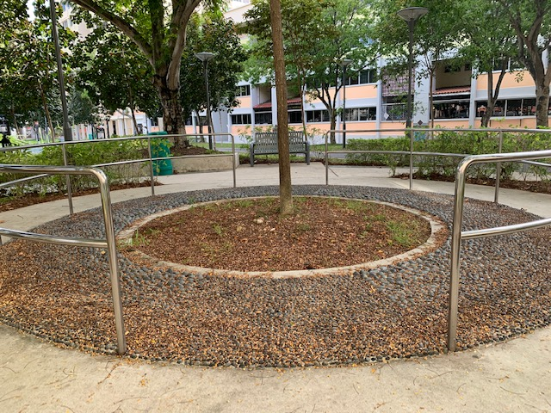
Adjust our Priorities
Gilgal (“to roll”) – home-base of operations for the Israelites during the initial conquest of the land

Slide 13
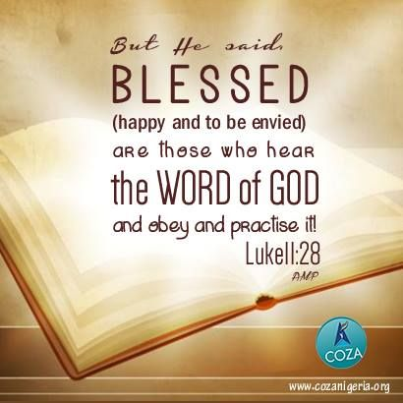
2
Act on God’s Word
Through faith and works

Slide 14
Act on God’s Word
The manna ceased the day after they ate of the produce of the land. And there was no longer manna for the people of Israel, but they ate of the fruit of the land of Canaan that year. (v 12)
The supernatural (manna) vs the natural (fighting)
Faith without works is dead (Jas 2:17)
Was not Abraham our father justified by works when he offered Isaac his son on the altar? Do you see that faith was working together with his works, and by works faith was made perfect? Jas 2:21-22 NKJV

Slide 15
Act on God’s Word
Do your best to present yourself to God as one approved, a worker who has no need to be ashamed, rightly handling the word of truth. 2 Tim 2:15 ESV
We do not want you to become lazy, but to imitate those who through faith and patience inherit what has been promised. Heb 6:12 NIV
Sow your seed in the morning, and at evening let not your hands be idle. Eccl 11:6 NIV

Slide 16
Act on God’s Word
²⁰ So the anger of the Lord was kindled against Israel, and he said, “Because this people have transgressed my covenant that I commanded their fathers and have not obeyed my voice, ²¹ I will no longer drive out before them any of the nations that Joshua left when he died, ²² in order to test Israel by them, whether they will take care to walk in the way of the Lord as their fathers did, or not.” ²³ So the Lord left those nations, not driving them out quickly, and he did not give them into the hand of Joshua. Judg 2:20-23 ESV

Slide 17
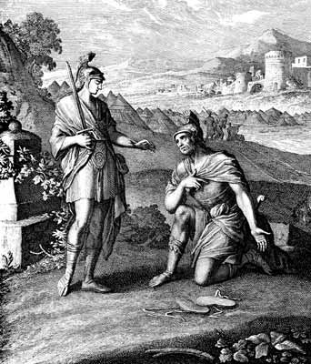
3
Acknowledge God
As the Captain of our lives

Slide 18
Acknowledge God
And Joshua went to him and said to him, “Are you for us, or for our adversaries?” And he said, “No; but I am the commander of the army of the Lord. Now I have come.” (v 13-14)
Joshua: Oshea “he saves” to Jehoshua“the Lord saves” (Num 13:16)
Worship and Obedience
  marching round the walls of Jericho (Josh 6:1-5)
  execution of Achan and his family (Josh 7:20-26)
  battle plans to conquer Ai (Josh 8:1-2, 18)

Slide 19
Acknowledge God
“And if it seems evil to you to serve the Lord, choose for yourselves this day whom you will serve, whether the gods which your fathers served that were on the other side of the River, or the gods of the Amorites, in whose land you dwell. But as for me and my house, we will serve the Lord.” Josh 24:15 NKJV

Slide 20
Acknowledge God
²⁹ Now it came to pass after these things that Joshua the son of Nun, the servant of the Lord, died, being one hundred and ten years old. ³¹ Israel served the Lord all the days of Joshua, and all the days of the elders who outlived Joshua, who had known all the works of the Lord which He had done for Israel. Josh 24:29,31 NKJV

Slide 21

Conclusion
Adjust our Priorities
Act on God’s Word
Acknowledge God

